Slide 1

Differences in Social Media Usage
Germany & Saudi Arabia in the spotlight
Jens Helge Reelfs†, Oliver Hohlfeld†, Niklas Henckell‡
†Brandenburg University of Technology
‡The Jodel Venture GmbH
Passive and Active Measurements Conference
March 30, 2022
Notes:
Hello & Welcome.
In the next couple of minutes,
we are gonna be talking about
Differences in Social Media Usage
--- Spotlighting Germany
& the Kingdom of Saudi Arabia
I am Helge, Researcher & PhD Student at BTU
– and this is joint work with Oliver & Niklas.
Thanks
for organizing PAM
And the Reviewers for their feedback
Due to time, I will be showing only a Sneak Peek.
packed with lots of content, but bear with me.
Let‘s get right into it & start with a short Motivation
(#)

Slide 2
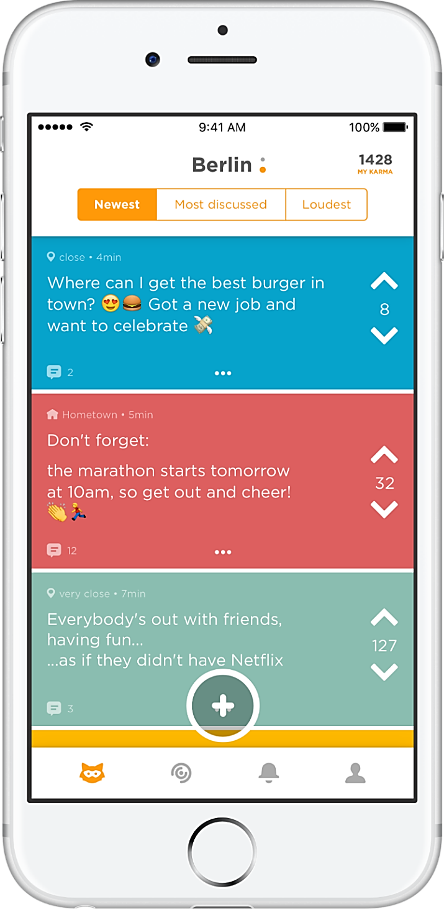



Motivation – Human Behavior in Social Media
Motivation – Human Behavior in Social Media
Community
Feed
24/7 everyday communication
Lots of platforms
  RW focuses single (US/EU) markets
We focus on Jodel
Unique design features
  Anonymity
  Hyperlocality
Given these very same features
  How do users use it?
  What are implications on user experience?
  Comparison DE - SA
But WHY
DE & SA?
a “Jodel”
(thread)
Distinct Communities
(by design)
Mining
Behavioral Differences
Up-/Downvote
& ‘Karma’
Notes:
Thanks to internet
Short Messaging & Social Media
dominates our everyday comunication.
(#) lots of RW;
However MOST focusses
on single community (US/EU market)
--- or they do not have distinct communities.
What we find & the main message is:
--- small world networks if applicable
--- the rich get richter, Power-Law
(#) In this work, we focus on Jodel.
Which combines 2 key design features
Anonymous
Hyperlocal
--- content is only displayed in the proximity of a user – ~20km
→ forming independet communities
(#) This made us wonder:
--- given the same ingredients,
do users use the platform similarly?
What do differences mean for the platform and user?
(#) So, some words about the app first
(#) Most important things are
Community
Different Content Feeds
We have actual contnt - Jodel Threads + replies underneath
We can vote Up- or Down – resulting in a cumulative Karma Score
(#) WHY?
1. Dataset
2. DE: birth, largest user base
3. SA: second largest user base
& a spatially very different region
(and different culture)
(#) Jodel is perfect:
- 2 countries
- Hundreds of independent communities
(#) Our Goal: Systematic Behavioral Differences – or invariant Similarities
(#)

Slide 3
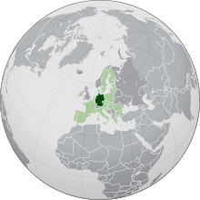
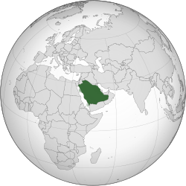


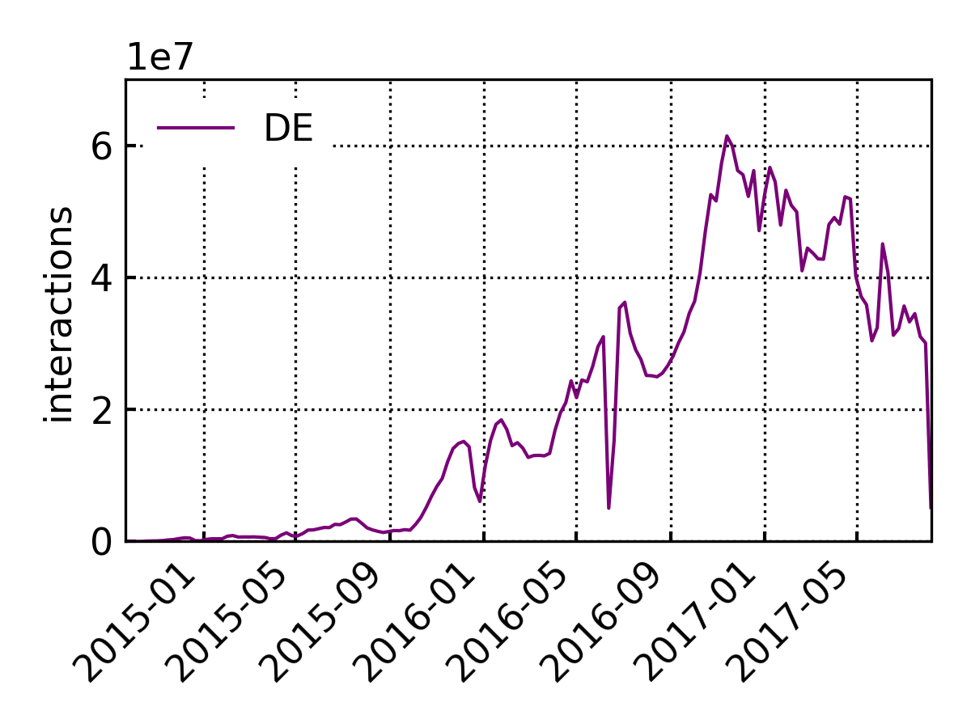
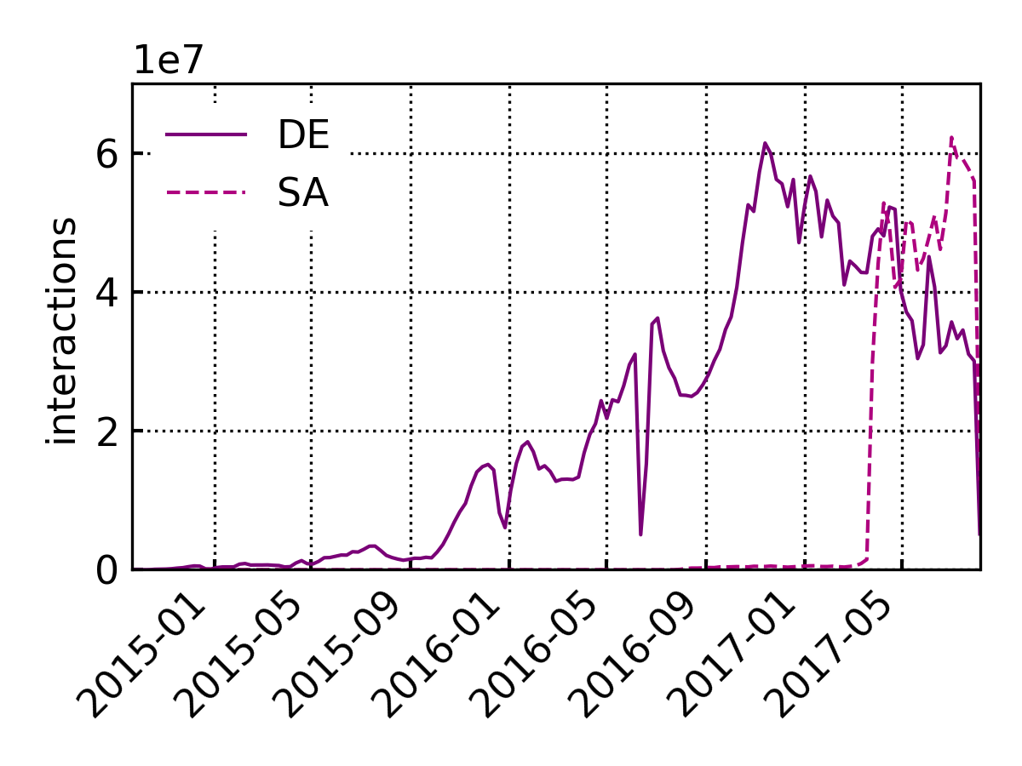

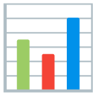
Dataset & Eval Backbone
*https://en.wikipedia.org/wiki/Saudi_Arabia
https://en.wikipedia.org/wiki/Germany
Ground truth information from operator
Natural Partitioning
  Country
  Time
  Activity
6m
Type | DE | SA
User | 3.6M | 1.2M
Content | 285M | 469M
Interaction | 3.0G | 961M
5 4 3 2 1 0
…
…
…
…
q75-100
q50-75
q25-50
q0-25
Aachen
…
DE
SA
Munich
Berlin
…
…
…
…
q75-100
q50-75
q25-50
q0-25
Wait,
what happened
Here?
Riyadh
Jeddah
…
Dammam
Organic
Growth
Notes:
(#) Ground Truth META data
(#) Now, we look into development over time.
DE first
(#) Organic Growth
(#) SA
Only really started in Mid March 2017
(#) But what happened here? - Sigmoid kick-start
-- we SUSPECT Jodel went viral on Social Media
--- that is another paper
(#) Partitioning
(#) By Country
(#) By Time: Independent time frames each 6 month,
we have interactions linked to communitíes
(#) we dissect this further by activity volume
(#) We continue with a User Perspective – and their interactions

Slide 4
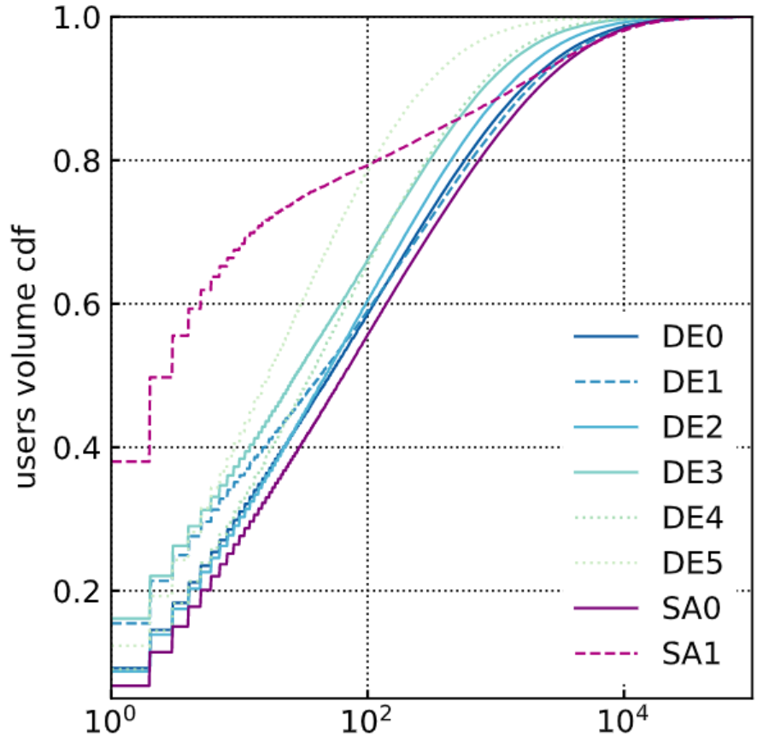
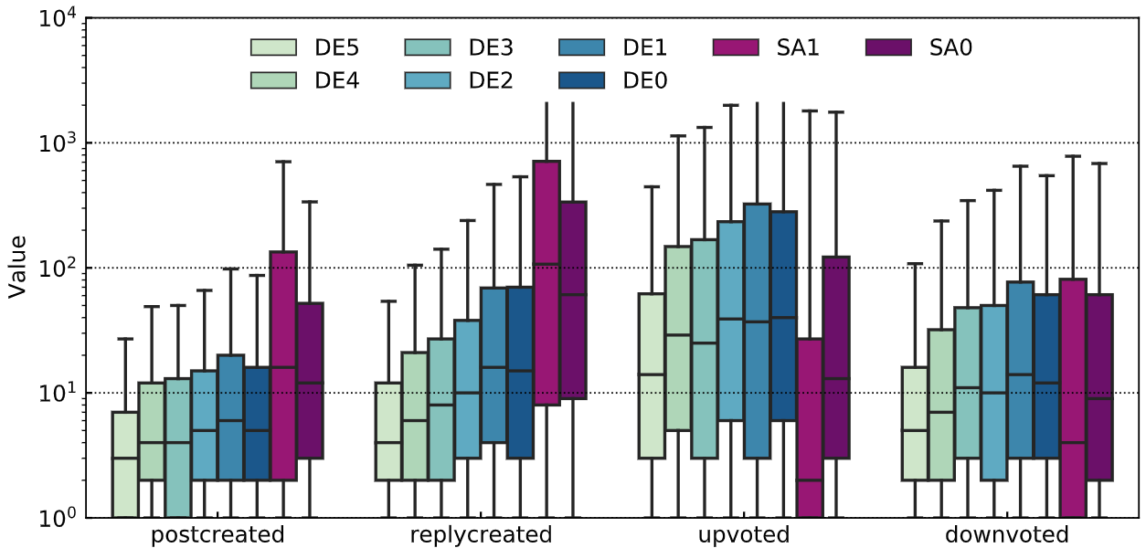

Users vs. Interactions
time
Ok, but
do they do the same?
Mostly
Casual Use
Similar,
Power-Law
No.
Notes:
(#) CDF interactions per user
within Independent time partitions!
(#) 60% only 100 interaction
--- Most users only Casual Use
(#) Disributions only shifted within x-log space.
Power Law.
SA1 = Outlier
(#) Do they do the same?
(#) We detail this in a boxplots by interaction type - again per user
Content creation - Thread & Reply
Voting - Up & Down
(#) as follows
gradual increase over time for DE
(#) As can be seen
there are significant deltas in log space
So, the apparent answer is sort of NO!
(WAIT 5 seconds)
Why? – We don’t know.
That’s the neat part of Future Work
But if you talk to people
from any MENA country,
they confirm this finding.
But more importantly,
(#) We will outline implications
for the very same platform properties next

Slide 5

Structural Implications
Voting
Scores
Content
Engagement Speed
Moderation
Discussions
Participation
Thread Length
Voting
Participation
Scores
Moderation
User Experience
Notes:
They are manifold.
What we can say:
The platform builds upon
Content
Voting
Along with them, many other aspects are of interest
All makes up for the ultimate user experience
being part of existing & future research
--- to be honest:
our SHORT paper only scratches the surface
(#) As we have observed a major shift in user attention.
(#) We will fous on Voting for now.

Slide 6
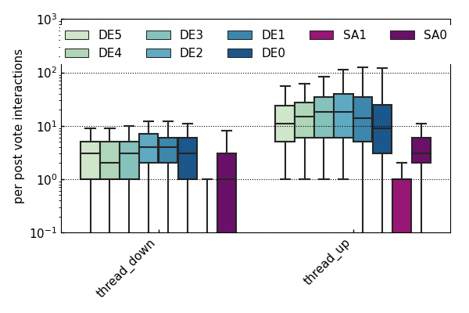
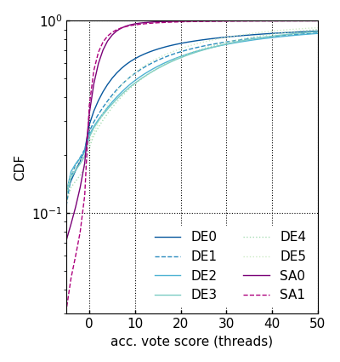

Major Attention Shifts - Voting
SA content
receives less votes
Understood,
implications?
Distributed
Content Moderation
Self-Reinforced
Voting
Notes:
For that, let‘s look into up and downvotes per thread
(#) which are as follows
(#) Due to lack of volume,
SA posts receive far less votes
In comparison to DE
(#) But what are the implications?
→ how does this translate into cumulative scores?
that dictate in-app content presentation
(#) We show a CDF of the resulting scores per post
There are huge differences for
(#) SA has LESS Outvoted Content
→ Distributed Moderation may suffer
(#) DE has much more posts with higher scores.
→ More positive content for user
positive feedback loop
--- there you go, two more paper ideas

Slide 7
Sneak Peek - Summary
Partition Data by Dynamics
  Country
  Time
  Activity
Given equal opportunity
  In-Country:
  Similar
  Cross-Crountry:
  Attention Shifts
Cultural Differences in Social Media Usage
Vantage Points matter!
Partition data
Analyze Patterns
Structural Implications
Notes:
In Summary What did we do?
(#) Partition
Country
Time
Activity
(#) Analyze Data
+ explore structural implications
on user experience
Largely the Same for IN COUNTRY
BUT Differences CROSS COUNTRY
(#) We presume a CULTURAL difference in Social Media Usage
That is often neglected by other research as of today.
(#) What remains terms of a Measurement Conference? Vantage Points matter!
(#)

Slide 8


Check out the paper for more!
... now it is time for discussions.
https://h.reelfs.de
Notes:
I hope you enjoyed this talk
Check Out the Paper for more
or talk to me later on
if interested in this topic, checkout my website as well
Thanks.

Slide 9
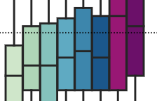

What happened
Here?

Slide 10
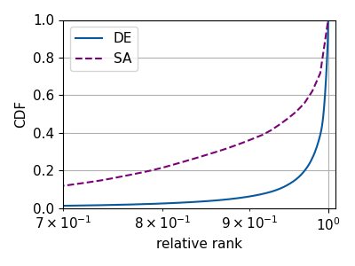
Dataset & Eval Backbone
*https://en.wikipedia.org/wiki/Saudi_Arabia
https://en.wikipedia.org/wiki/Germany
Ground truth information from operator
Natural Partitioning
  Country
  Time
  Activity
6m
Type | DE | SA
User | 3.6M | 1.2M
Content | 285M | 469M
Interaction | 3.0G | 961M
5 4 3 2 1 0
…
…
…
…
q75-100
q50-75
q25-50
q0-25
q75-100
q50-75
q25-50
q0-25
Aachen
…
DE
SA
Munich
Berlin
…
…
…
…
q75-100
q50-75
q25-50
q0-25
Riyadh
Organic
Growth
Jeddah
Wait,
what happened
Here?
…
Dammam
Notes:
META data
Independent time frames

